Slide 1
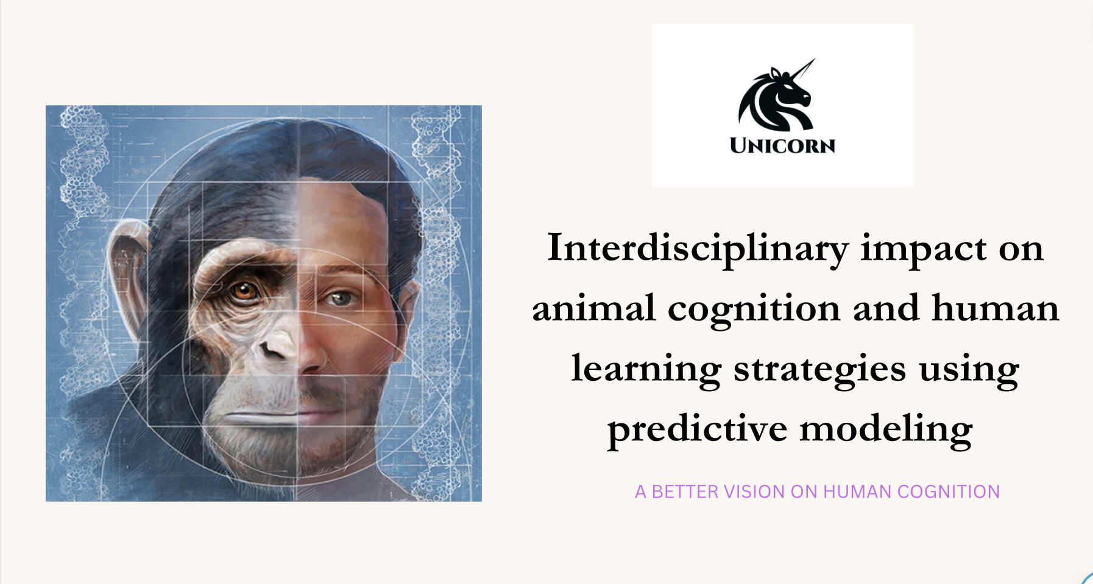

Slide 2
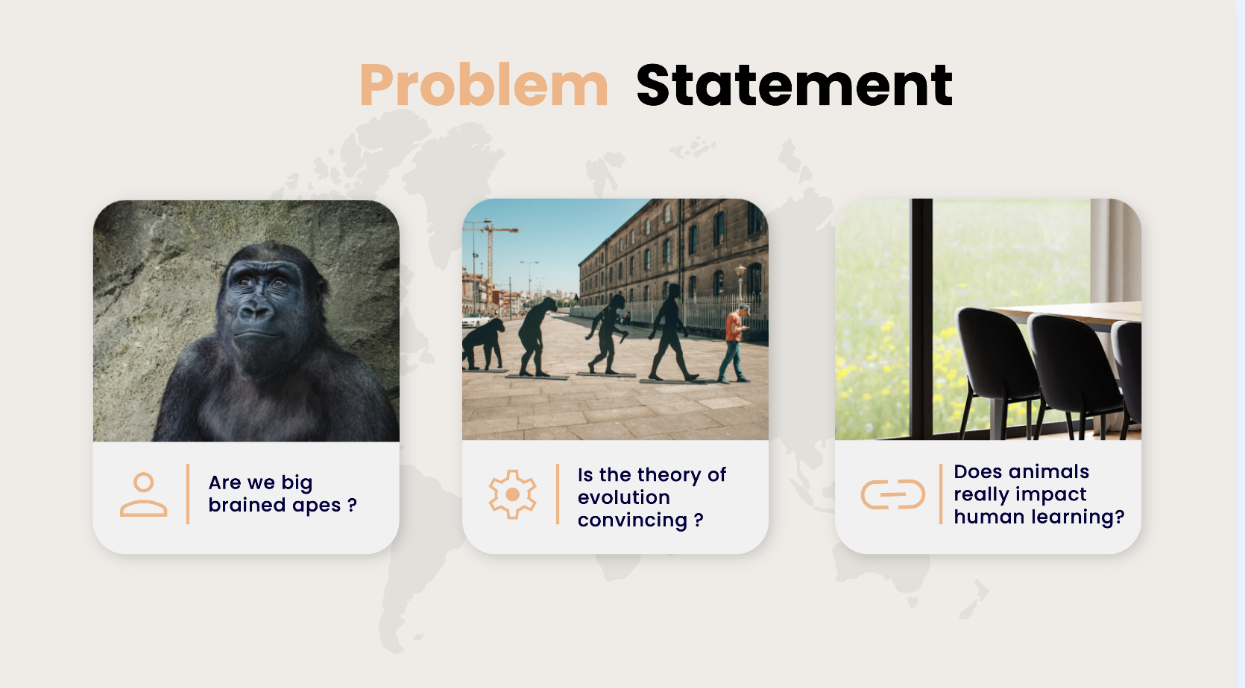

Slide 3
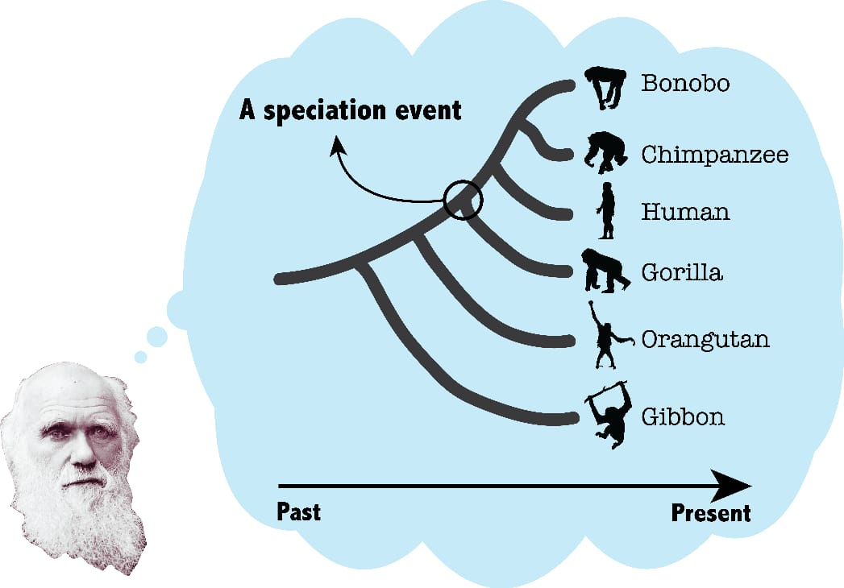
MOTIVATION
Evolution is not a linear process that starts with more “primitive” looking organisms we can observe today, and ends in mankind.
Cladogenetic events are the moments in time during which one species “splits” into two species – these events are also known as speciation events.
This idea of universal relatedness, also known as common descent, was proposed by none other than Charles Darwin himself in On the origin of species

Slide 4
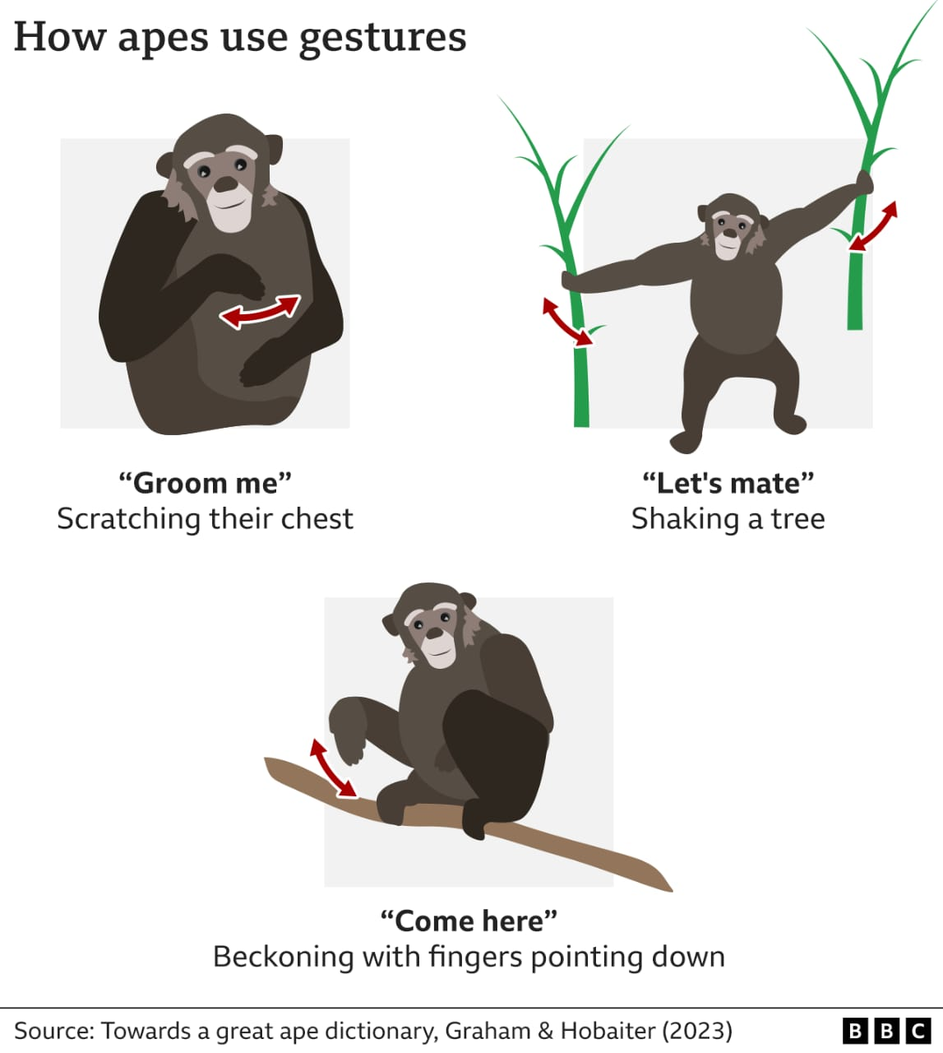
Role of Predictive
Modeling as an anticipating tool
E . Sue Savage-Rumbaugh, Jeannine Murphy, Rose A. Sevick, Karen E. Brakke, Shelly L. Williams, Duane M. Rumbaugh , "Language Comprehension in Ape and Child" emphasises the overlooked aspect of comprehension in language development.
Results show that the physical adaptation enabled the evolution of a speech-like mode of communication in hominids. To make these results more accurate, a number of such experiments can be conducted and the data can be used in an organized way by employing predictive modelling.

Slide 5

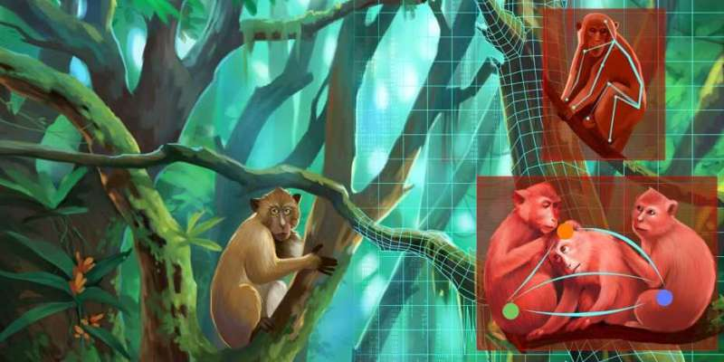
Factors favouring our research
Availability of Large Dataset
Improved Algorithms and Machine Learning techniques
Natural Language Processing
Historical Evidences
Genetical Neuroscience Research

Slide 6
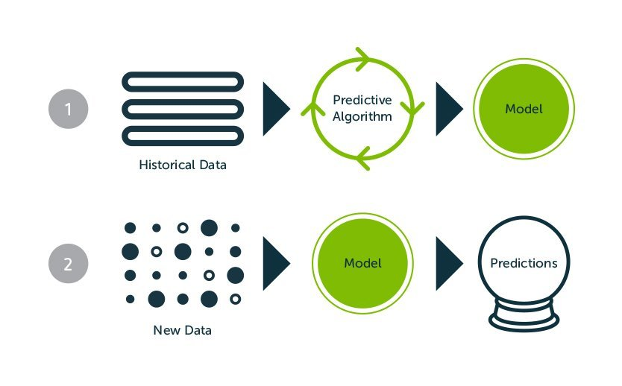
How does predictive modeling works ?

Slide 7
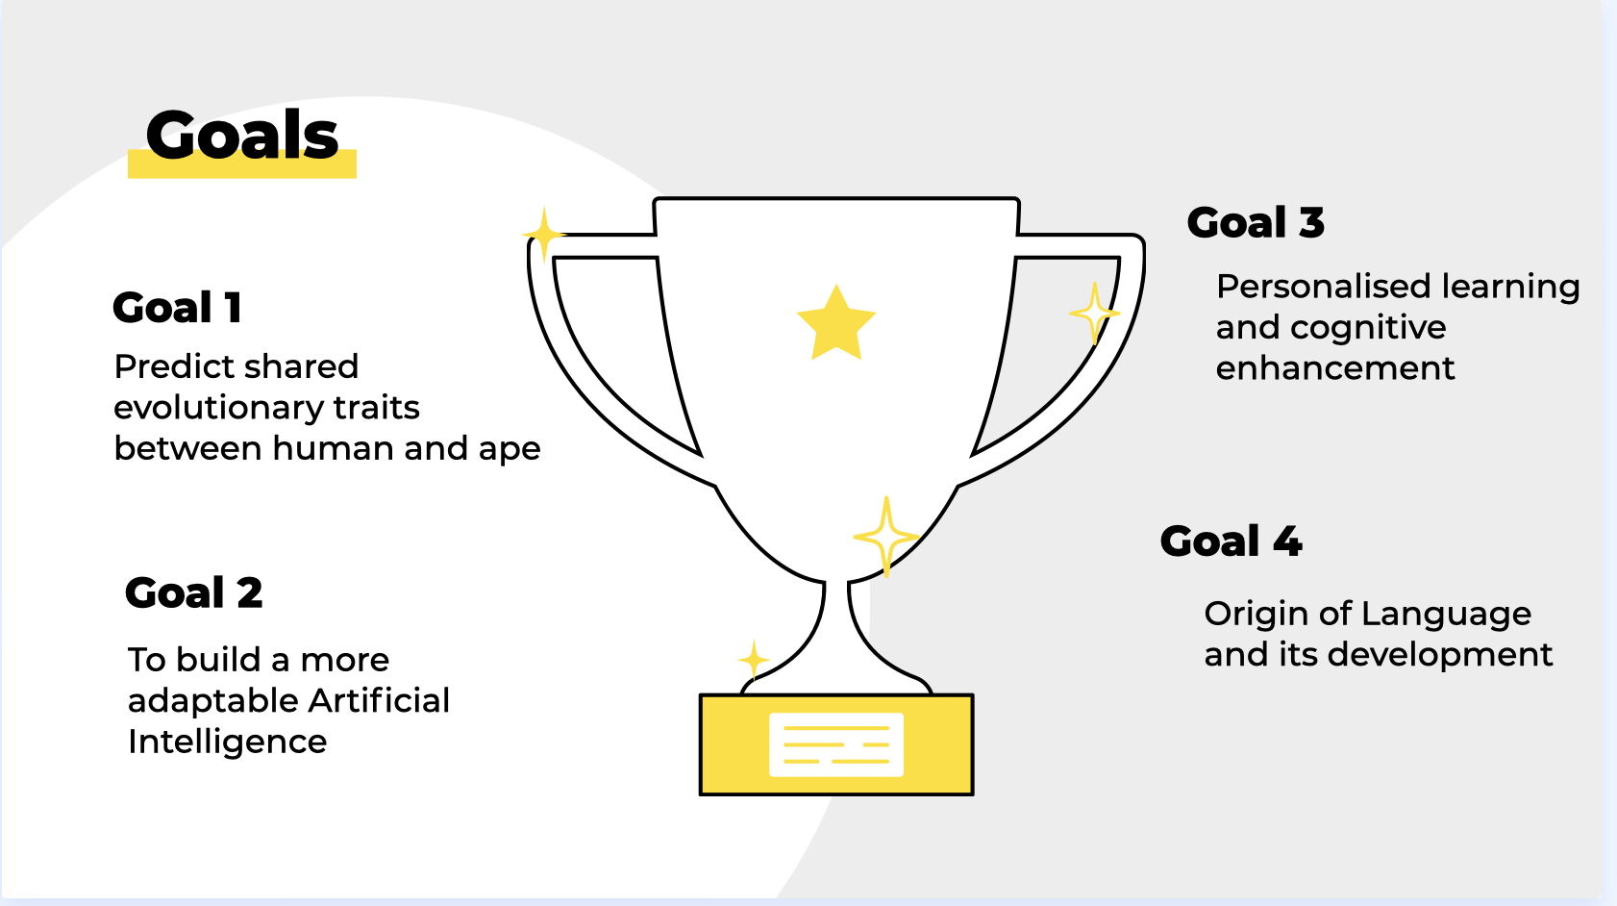

Slide 8
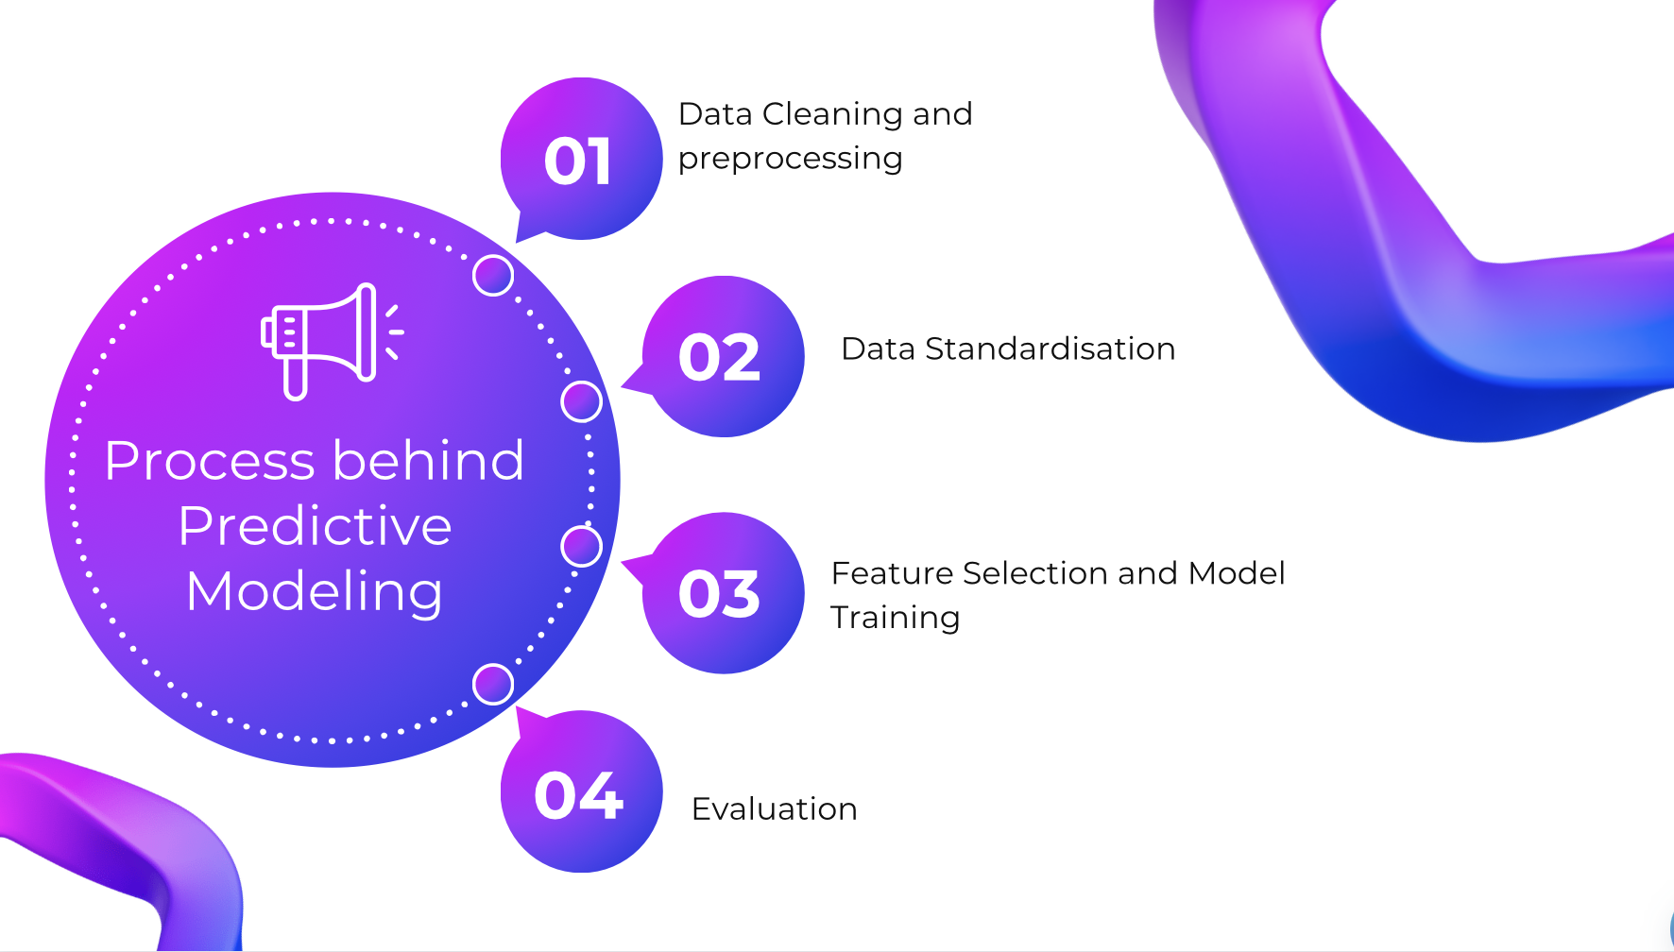
Training Data and
Testing Data

Slide 9
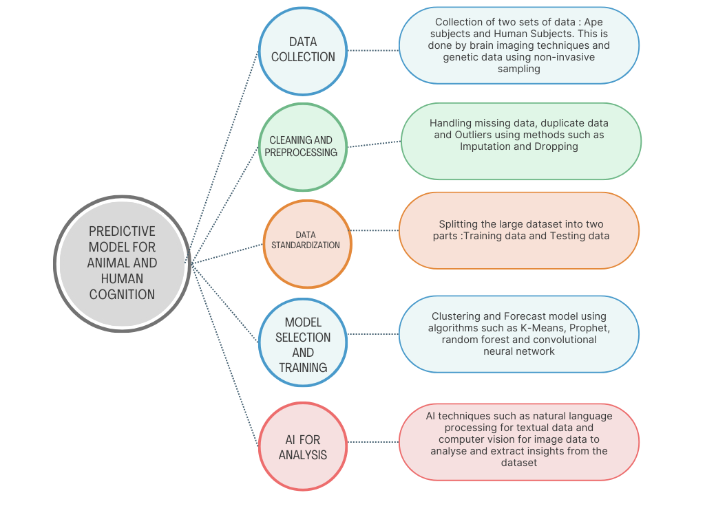
PREDICTIVE MODELING - OUTLINE

Slide 10
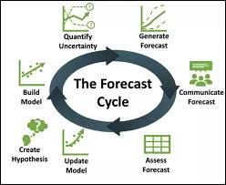
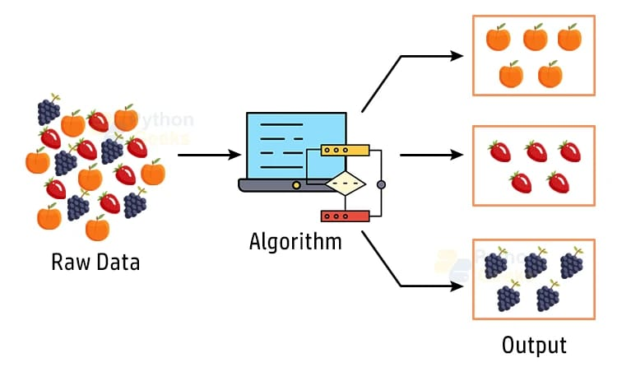
PREDICTIVE ANALYTICS MODELS
Clustering Model
Forecast Model

Slide 11
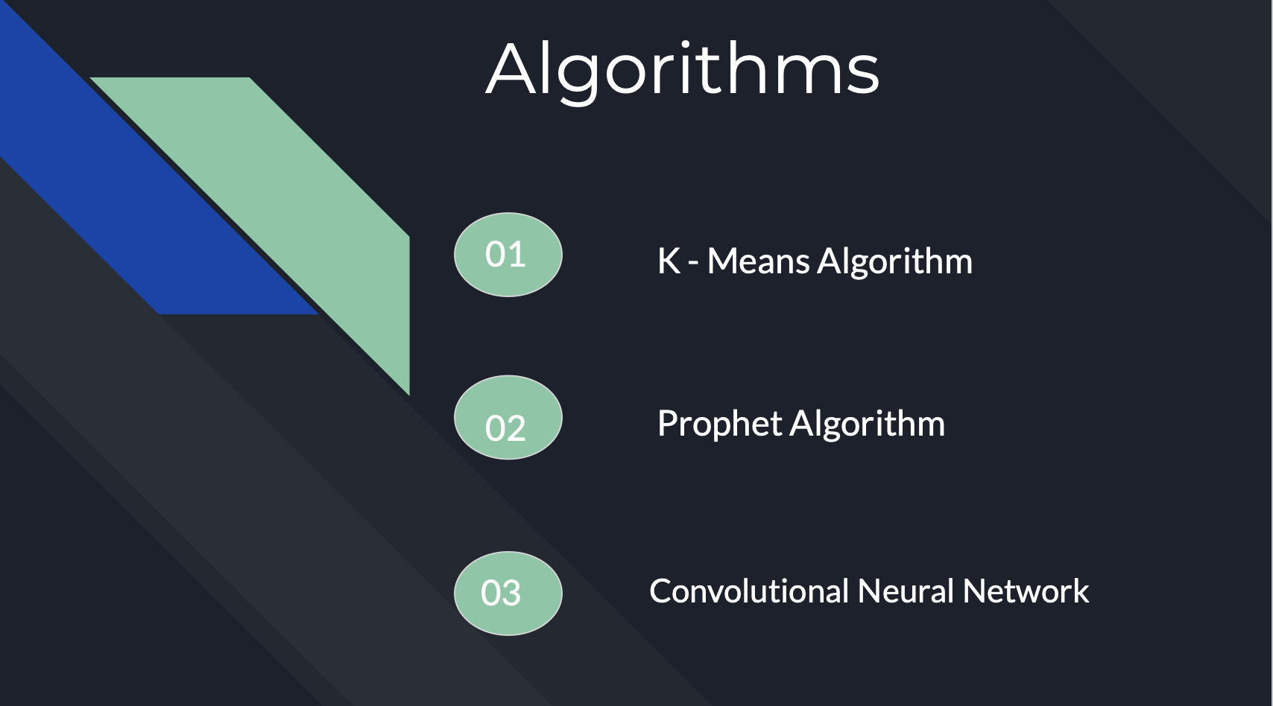
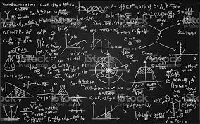
An unsupervised algorithm for clustering that partitions observations into k clusters based on the nearest mean, iteratively refining cluster centroids.
A forecasting tool by Facebook optimized for time series with seasonal patterns, handling trends and holiday effects through model components.
A deep learning algorithm tailored for visual data, using convolution operations to automatically learn and extract features from images for tasks like recognition and analysis.

Slide 12
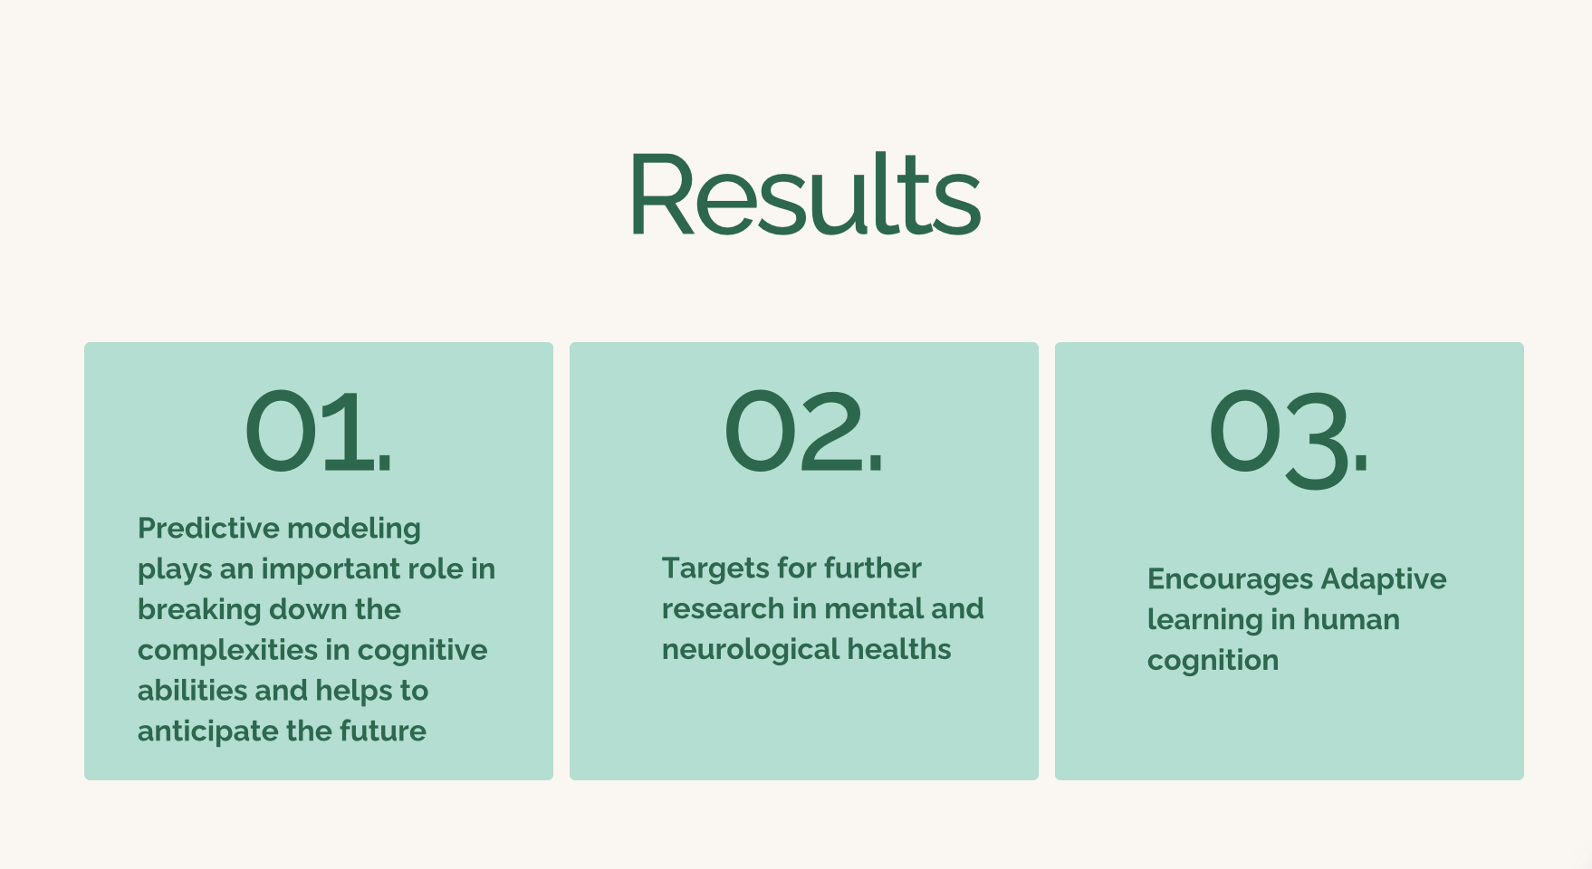

Slide 13
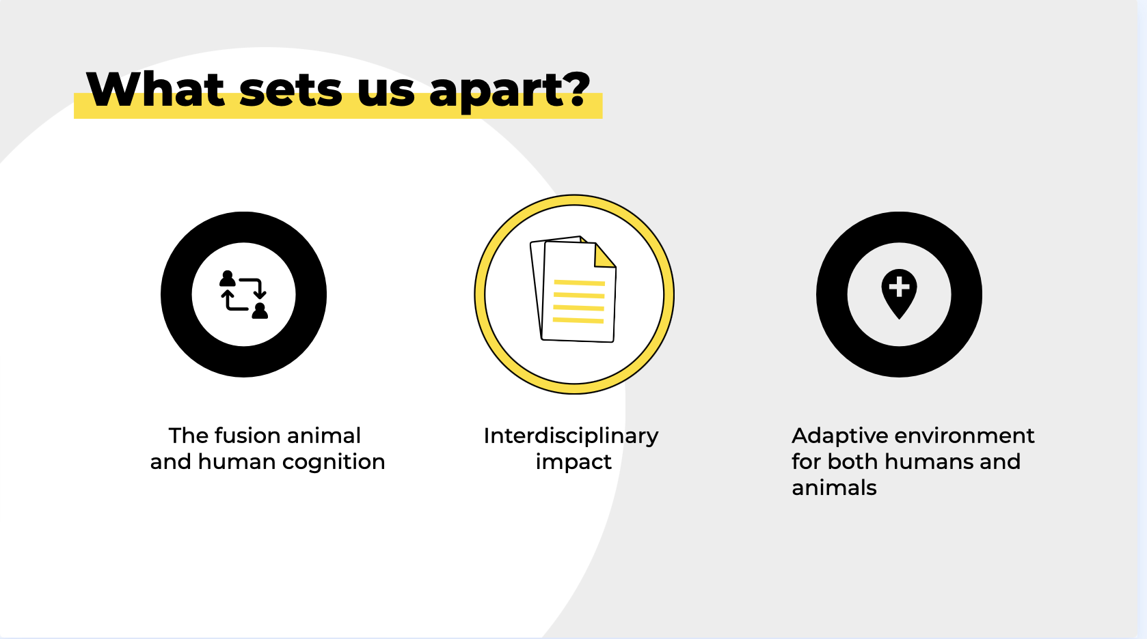

Slide 14


THANK YOU

